Slide 1
Input Modeling
OPER 561 Discrete-Event Simulation
Lesson 12
Notes:
Simio exam due 4pm.
HW 2 due today too.
HW 3 assigned. [remark about using book to guide HW from book]
Exam 2 study guide on Canvas (today’s page has a link). Exam review Tuesday—come with questions.

Slide 2
Lesson objectives
Appreciate that output quality is no better than input quality
Describe the four steps of input model development
Use a goodness of fit test to assess an input distribution

Slide 3
Input Modeling
Data collection
Input distribution
Distribution parameters
Goodness of fit
Notes:
Save time for midterm feedback surveys

Slide 4
Has the data been collected correctly?
This is important! Poor data → poor models
Poor data: missed observations, wrong units, data censoring, measured wrong thing, …
Practice data collection & check as you go

Slide 5
Suppose the data is poor & unsalvageable or that no data is available in the first place
Consult engineering data for process/product
Get SME opinions—they can estimate best-/worst-case, averages, variability
Consider physical performance limits & the nature of the process
Uniform, triangular, & beta often used here
Notes:
See BCNN Ex. 9.20 for approach to solicit a distribution from expert opinion *

Slide 6
Input Modeling
Data collection
Input distribution
Distribution parameters
Goodness of fit
Notes:
For now, we’re going to assume good data has been collected (though maybe not as many samples as we’d like).

Slide 7
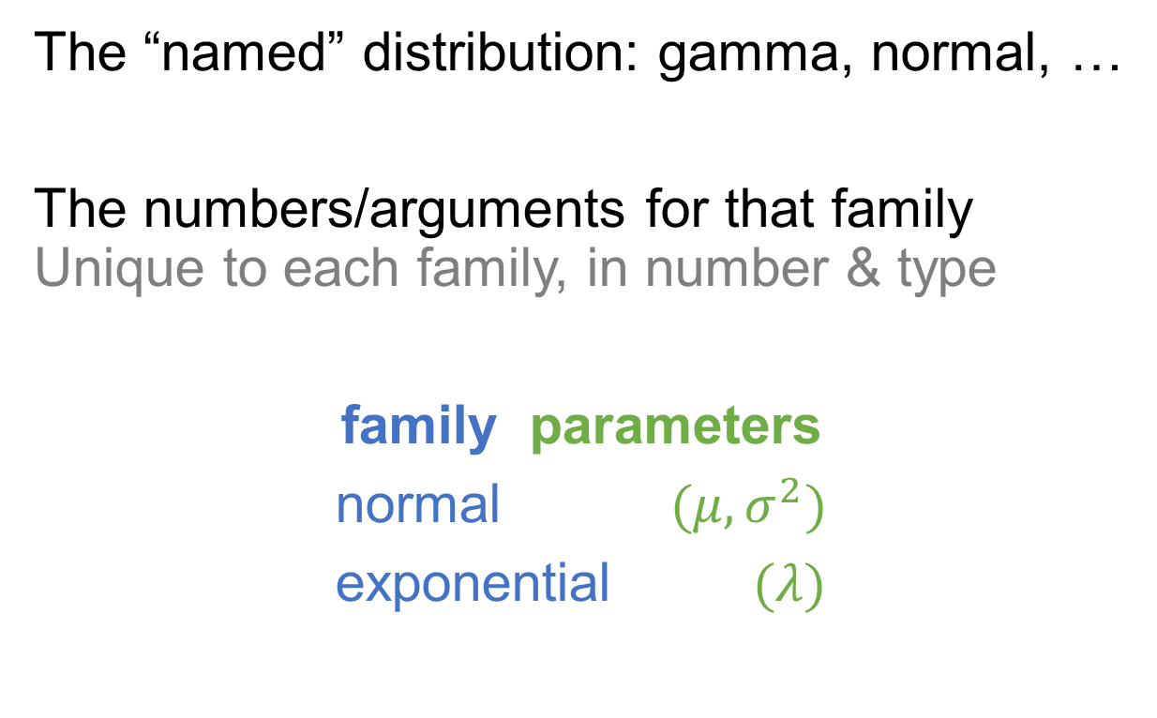
A probability distribution has two parts
Family
Parameters
The “named” distribution: gamma, normal, …
The numbers/arguments for that family Unique to each family, in number & type
family parameters
normal $(μ, σ^{2})$
exponential $(λ)$

Slide 8
Start by selecting a family for the input distribution
First, consider the context or physical basis of the input variable See the list in BCNN 9.2.2
Then if sample data is available, examine a histogram or a Q-Q plot
The goal is a good approximation; no true distribution exists for any stochastic process
Notes:
Re: physical basis – is the process naturally discrete or continuous? Is it bounded? These (and other questions) should limit your choice

Slide 9
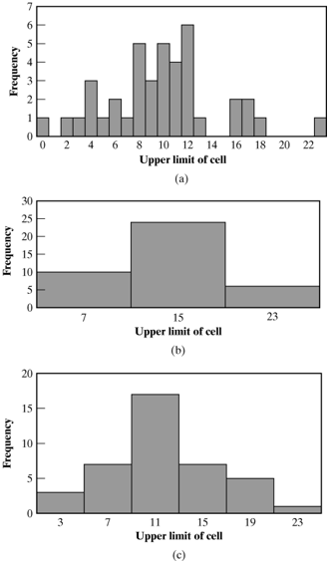
Histograms are useful for determining the shape of a distribution, but care is needed
You control the # of bins, and that affects the histogram’s shape quite a lot
The goal is to capture the pdf or pmf of the data to compare to known distributions

Slide 10
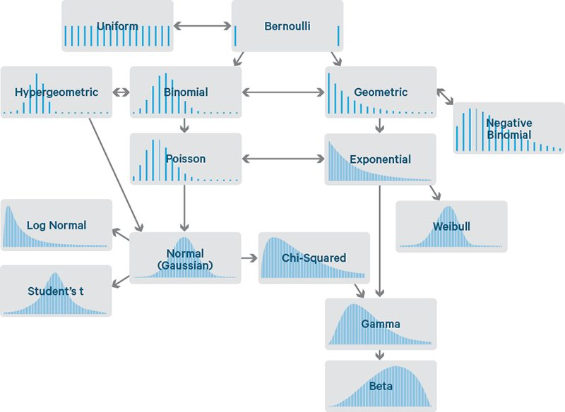
Notes:
https://www.datasciencecentral.com/common-probability-distributions-the-data-scientist-s-crib-sheet/

Slide 11
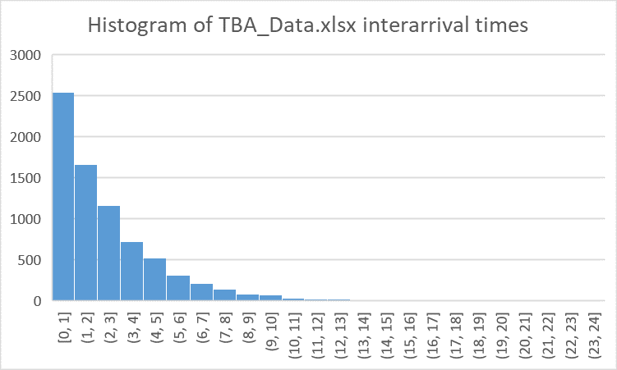
Let’s look at your histograms from the pre-work (for TBA_Data.xlsx)
In groups, compare histograms
Drill down into differences and justify your design choices (# bins, bin size, etc.)
Notes:
Budget 6 minutes
Based on histograms & understanding of the process, propose a distribution family.

Slide 12
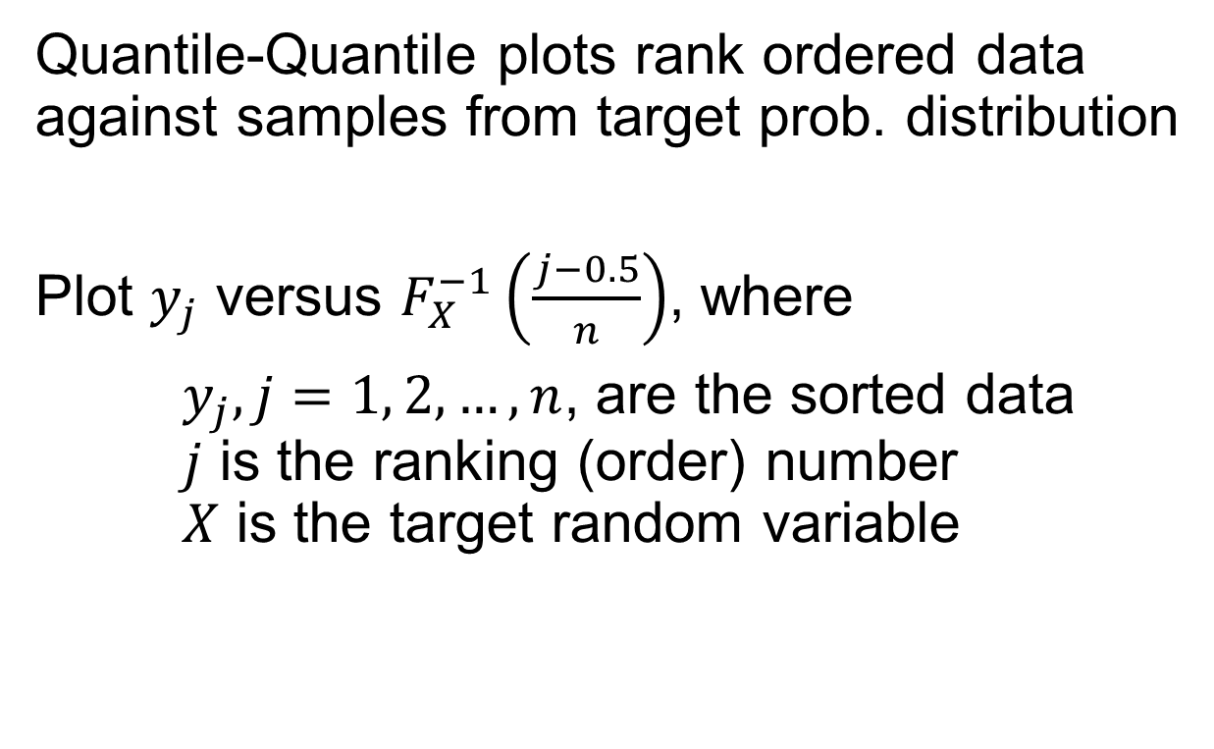
Histograms are a qualitative approach; for a more quantitative result, use a Q-Q plot
Quantile-Quantile plots rank ordered data against samples from target prob. distribution
Plot $y_{j}$ versus $F_{X}^{−1}\left(\frac{j−0.5}{n}\right)$, where
$y_{j}, j=1, 2, …, n$, are the sorted data $j$ is the ranking (order) number $X$ is the target random variable

Slide 13
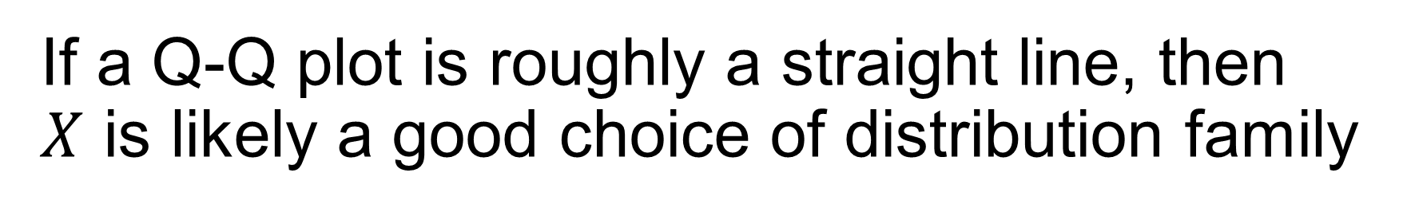
If a Q-Q plot is roughly a straight line, then $X$ is likely a good choice of distribution family
If the roughly straight line has slope 1, then the parameter values are also appropriate More on parameter selection later
Straight lines at the tails are less important (and rare) versus the middle of the plot
> Q-Q plot example in Excel

Slide 14
Sample data will never produce exact results, so you will need to make a judgement call
Points on Q-Q plot will never fall on exactly straight line, particularly at the extremes
The ordered (sorted) values are ranked and therefore not independent So points won’t be scattered about the line
If there’s no satisfactory choice, the empirical distribution is an option (but this has costs)
Notes:
Costs of empirical: sample data may have missed important/extreme behavior; large samples probably need pre-processing/reduction, and all samples will need more cleaning than if you fit a theoretical dist.

Slide 15
Input Modeling
Data collection
Input distribution
Distribution parameters
Goodness of fit

Slide 16
Once you have selected a distribution family, you need to estimate the specific parameters
Which “member” of the family fits your data?
Sample mean and variance are needed for many dist. families (not population variance!)
A parameter is an unknown constant, but an estimator is a statistic (i.e., random variable)
Notes:
The sample provides the best & likely only means of estimating parameters
-- “estimate” because you are using sample data

Slide 17
There are mathematical procedures for estimating distribution parameters
Method of Moments
Maximum Likelihood Estimation
Note that each parameter estimate is a random variable, so they won’t be perfect
The maximum likelihood is that you’ll use software to get estimates (more on that soon)
Notes:
The various theoretical distributions have known estimators (see BCNN Table 9.3). You can learn where those come from & how to make your own estimators for non-standard distros in OPER 661.

Slide 18
Input Modeling
Data collection
Input distribution
Distribution parameters
Goodness of fit

Slide 19
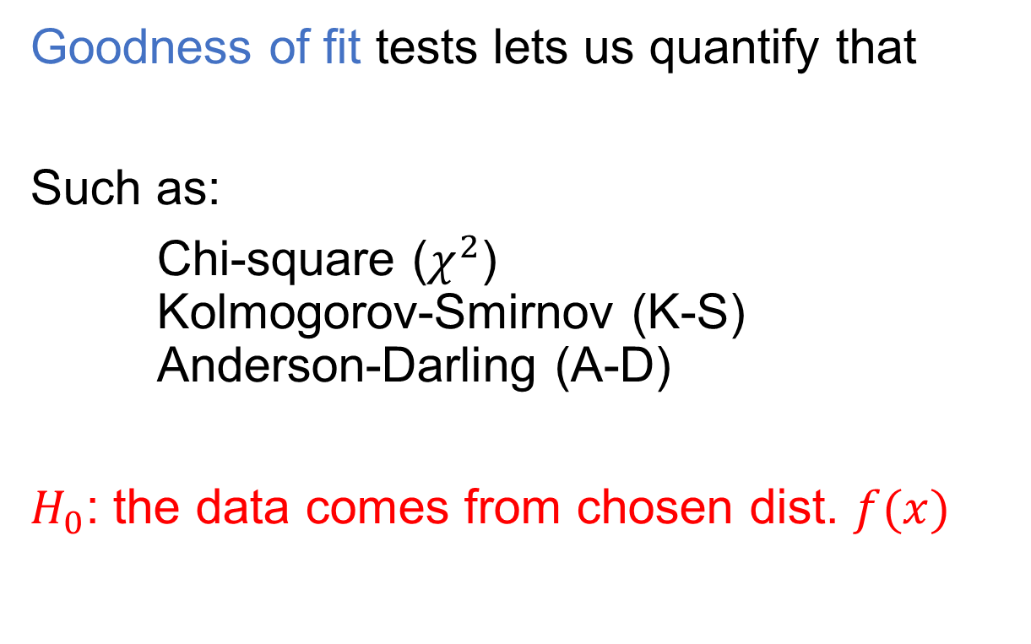
So you’ve picked a distribution for your data... Is it a good one? How sure are you?
Goodness of fit tests lets us quantify that
Such as:
Chi-square ($χ^{2}$) Kolmogorov-Smirnov (K-S) Anderson-Darling (A-D)
$H_{0}$: the data comes from chosen dist. $f(x)$

Slide 20
These tests give us confidence in our choice, but no single correct dist. exists in reality
If very little data, unlikely to reject any dist.
If lots of data, likely to reject all distributions
According to BCNN: very little < 50 lots > 200
Key point: tests provide evidence, not orders

Slide 21

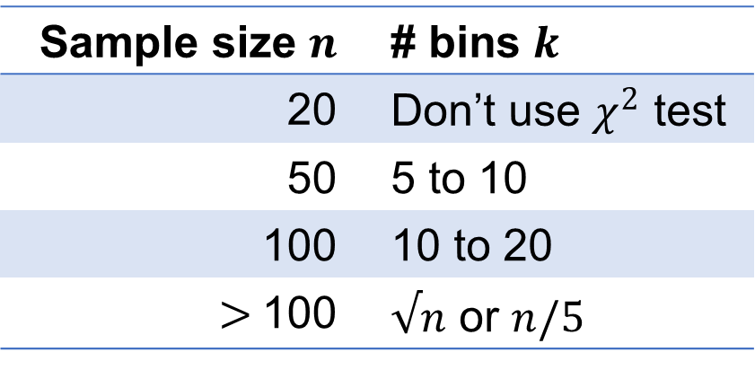
Chi-square test “compares” sample data’s histogram to shape of the chosen pdf/pmf
Preferred # of bins (for continuous data)
$H_{0}$: the data conforms to chosen dist. $f\left(x\right)$ $H_{a}:$ the data does not conform to $f(x)$
Arrange the data into bins and compute the observed & expected (by $f(x)$) frequencies
Sample size $n$ | # bins $k$
20 | Don’t use $χ^{2}$ test
50 | 5 to 10
100 | 10 to 20
$>$100 | $√n$ or $n/5$
Notes:
Caution: different grouping of data can affect the outcome of the hypothesis test

Slide 22
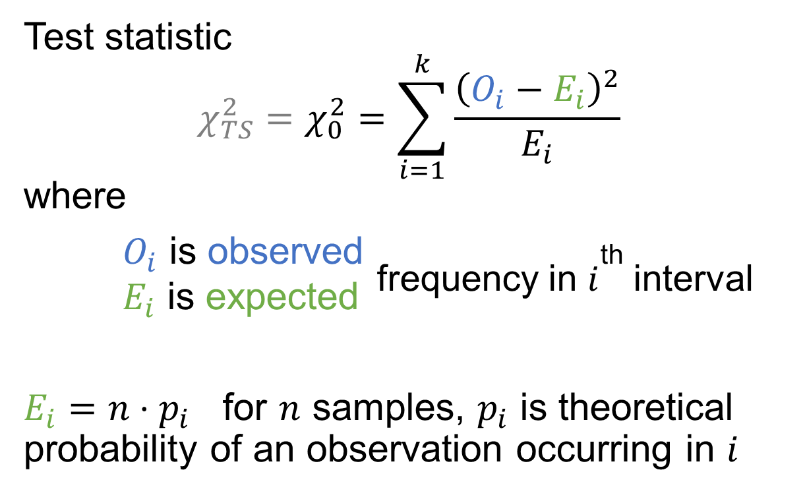
Chi-square test
Test statistic $$χ_{TS}^{2}=χ_{0}^{2}=\sum_{i=1}^{k}{\frac{{\left(O_{i}−E_{i}\right)}^{2}}{E_{i}}}$$ where $O_{i}$ is observed _{frequency in} $i$th _{interval} $E_{i}$ is expected
$E_{i}=n⋅p_{i}$ for $n$ samples, $p_{i}$ is theoretical probability of an observation occurring in $i$

Slide 23
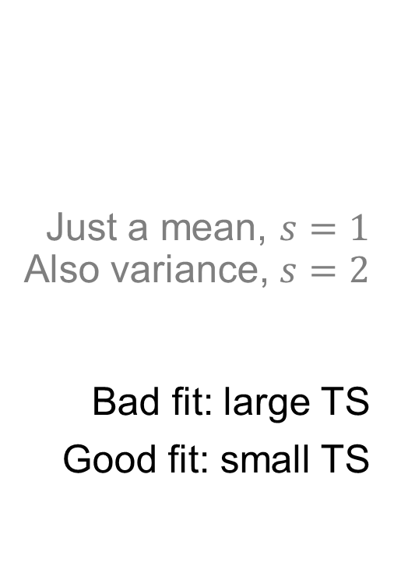
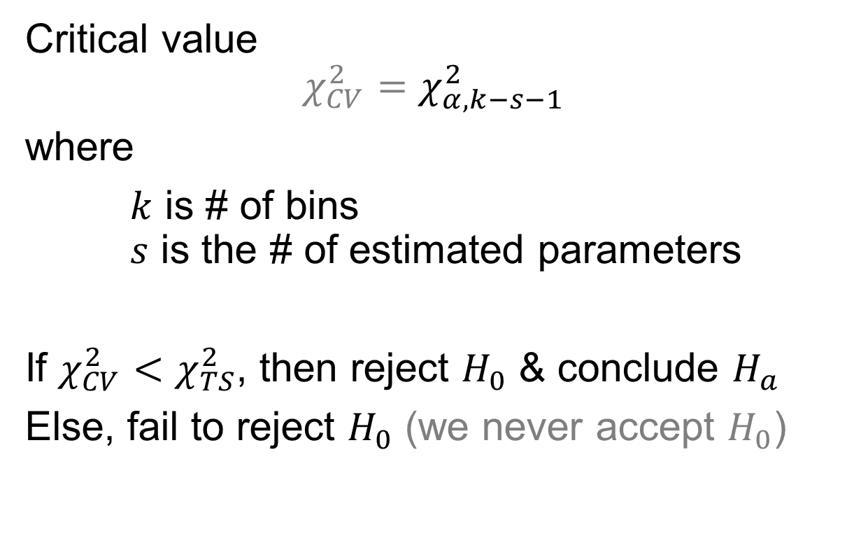
Chi-square test
Just a mean, $s=1$ Also variance, $s=2$
Bad fit: large TS
Good fit: small TS
Critical value $$χ_{CV}^{2}=χ_{α, k−s−1}^{2}$$
where
$k$ is # of bins $s$ is the # of estimated parameters
If $χ_{CV}^{2}<χ_{TS}^{2}$, then reject $H_{0}$ & conclude $H_{a}$
Else, fail to reject $H_{0}$ (we never accept $H_{0}$)
Notes:
Intuition: if H_0 is true, then test stat → critical value as n → infinity
Good/bad fit is re: data conforming to f(x)

Slide 24
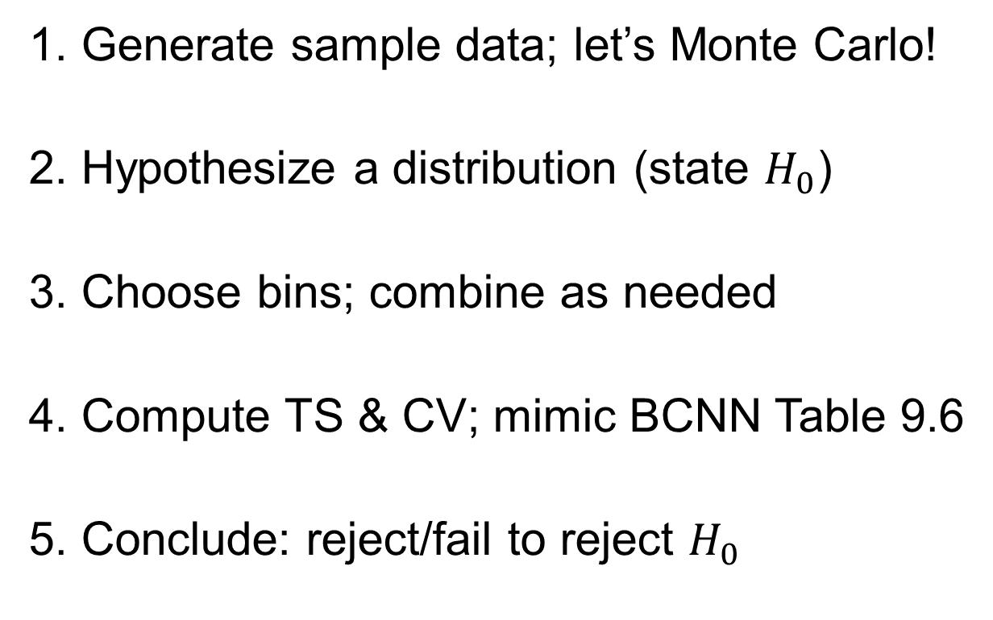
Chi-square test example – sum of rolling 2d6
1. Generate sample data; let’s Monte Carlo!
2. Hypothesize a distribution (state $H_{0}$)
3. Choose bins; combine as needed
4. Compute TS & CV; mimic BCNN Table 9.6
5. Conclude: reject/fail to reject $H_{0}$
Notes:
In groups or solo, do this.
Budget 25 minutes before wrapping this up.

Slide 25

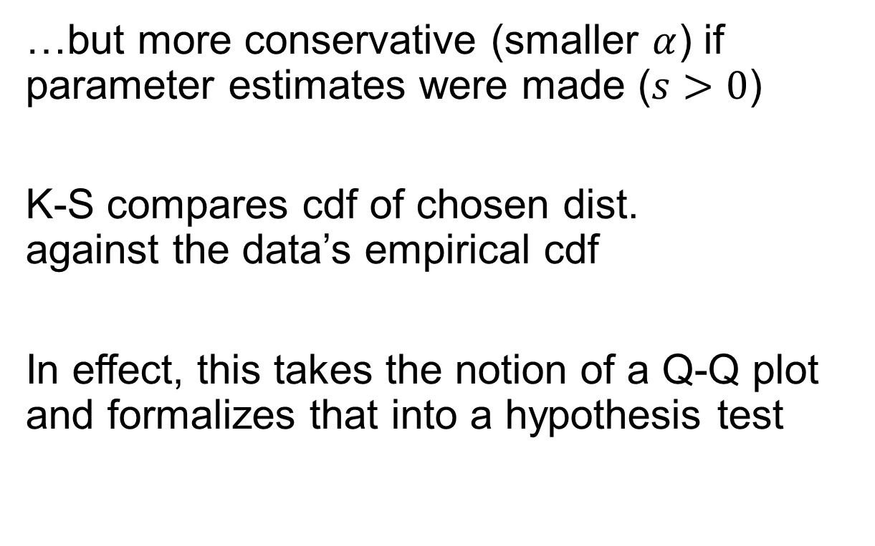
Kolmogorov-Smirnov test is a more powerful & robust test for small samples or $s=0$
…but more conservative (smaller $α$) if parameter estimates were made ($s>0$)
K-S compares cdf of chosen dist. against the data’s empirical cdf
In effect, this takes the notion of a Q-Q plot and formalizes that into a hypothesis test
Notes:
s is # of parameters estimated, not the sample st.dev.

Slide 26
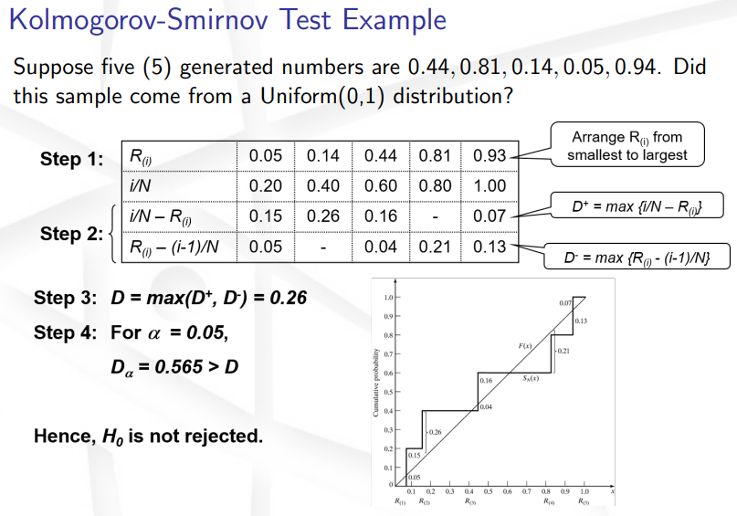
Notes:
Example from Dr. Champagne’s lecture notes. Same hypotheses and interpretation of the results (TS vs. CV), different procedure.

Slide 27
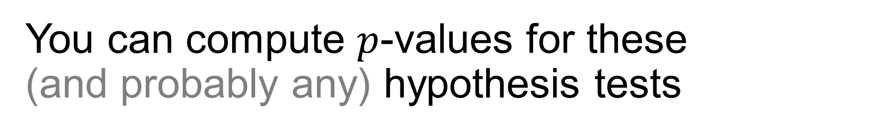
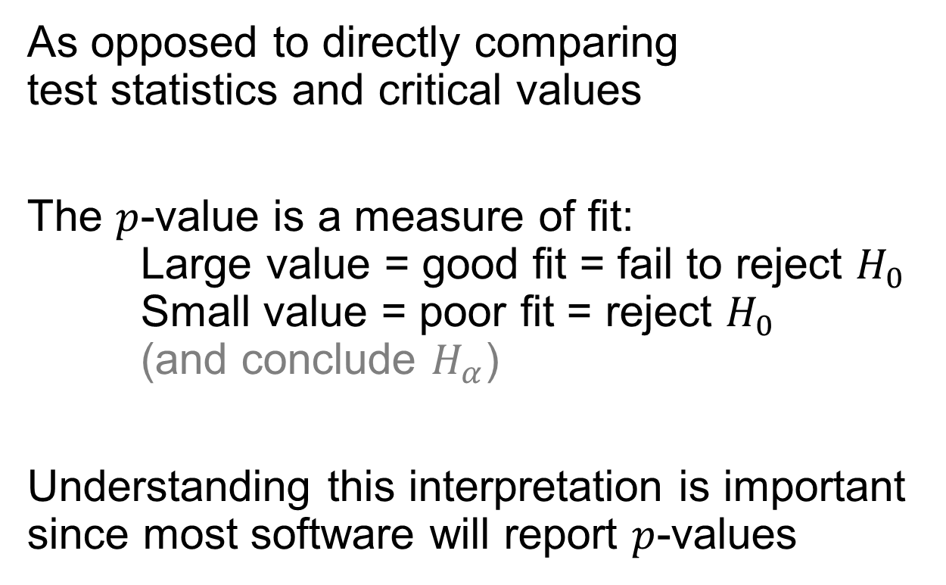
You can compute $p$-values for these (and probably any) hypothesis tests
As opposed to directly comparing test statistics and critical values
The $p$-value is a measure of fit: Large value = good fit = fail to reject $H_{0}$ Small value = poor fit = reject $H_{0}$ (and conclude $H_{α}$)
Understanding this interpretation is important since most software will report $p$-values
Notes:
P-value and alpha are related, but not necessarily equal, depending on whether a one-tailed or two-tailed hypo. test is used
Segue into software on next slide…

Slide 28
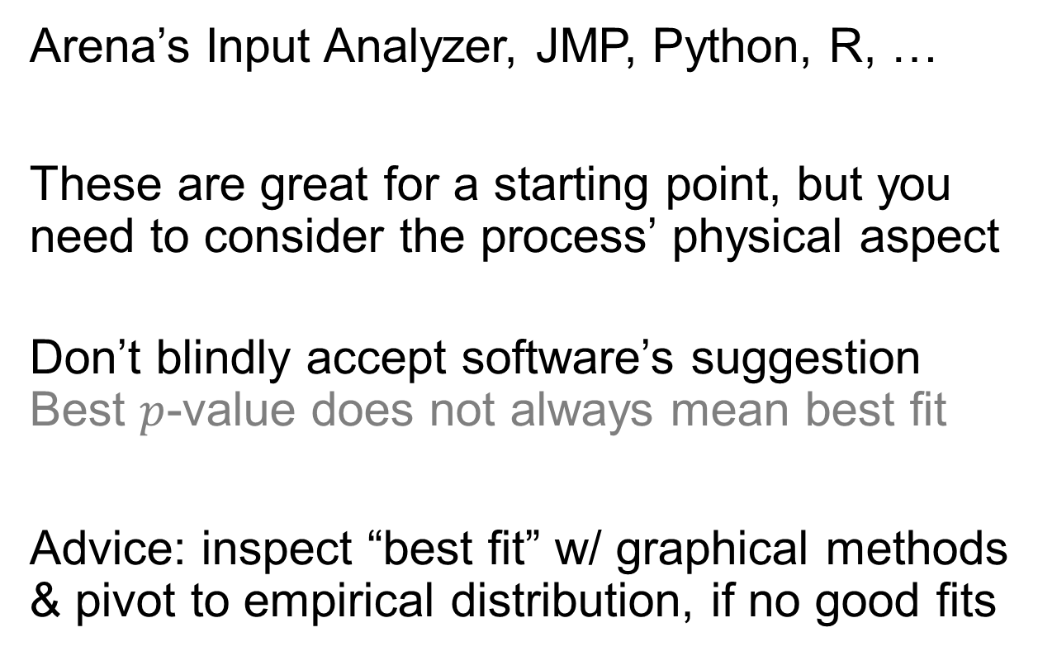
Software exists for fitting distributions to data
Arena’s Input Analyzer, JMP, Python, R, …
These are great for a starting point, but you need to consider the process’ physical aspect
Don’t blindly accept software’s suggestion Best $p$-value does not always mean best fit
Advice: inspect “best fit” w/ graphical methods & pivot to empirical distribution, if no good fits
Notes:
(repeat) Re: physical basis – is the process naturally discrete or continuous? Is it bounded? These (and other questions) should limit your choice
Activity: fit the TBA data…if running short on time, just demo IA (need to save 10min for feedback survey); else:
Input Analyzer – available on Canvas files/software
python/r/matlab distribution fitting – google it

Slide 29
Input Modeling
Data collection
Input distribution
Distribution parameters
Goodness of fit

Slide 30
Lesson objectives
Appreciate that output quality is no better than input quality
Describe the four steps of input model development
Use a goodness of fit test to assess an input distribution
Notes:
Midterm exam study guide is posted. Come with questions next time for review.
Save time for midterm feedback surveys.

Slide 31
Learning outcomes: At the end of this course, students will be able to:
LO 1. Construct or modify a simulation model in response to a system description using discrete-event simulation methodology.
LO 2. Differentiate between important and trivial sources of randomness or variability in real-world processes.
LO 3. Describe the theory behind popular random variate generation techniques and understand how they are implemented in computer simulation.
LO 4. Analyze the output of a computer simulation to estimate system performance parameters.
LO 5. Evaluate alternative system designs using simulation.
LO 6. Carry out the process of model verification and validation.

